Slide 1

Advances in Algorithms
for Matrix Approximation
Thesis Proposal:
via Sampling and Sketching
Taisuke (Tai) Yasuda
Thesis Committee:
David P. Woodruff (Carnegie Mellon University, Chair)
Anupam Gupta (Carnegie Mellon University)
Richard Peng (Carnegie Mellon University)
Cameron Musco (University of Massachusetts Amherst)
April 10, 2023

Slide 2
Matrix Approximation
“Turning big data into tiny data”
Matrix approximation is the problem of approximating large matrices by smaller matrices
Modern large-scale machine learning problems deal with huge matrices!
Billions of training examples and labels
Thousands of features
Goal: replace a large dataset with a smaller dataset to improve efficiency of data analytic tasks

Slide 3
Matrix Approximation
Randomized Numerical Linear Algebra
Numerical linear algebra [pre 2000’s]: deterministic algorithms for solving linear algebra to machine precision
Randomized numerical linear algebra [2000’s]: randomized approximation algorithms for numerical linear algebra
Randomized: succeed every time → succeed with 99% probability
Approximation: solve exactly → solve up to (small) error
This flexibility leads to extraordinary improvements in efficiency!
Key techniques: sampling, sketching, and optimization

Slide 4
Matrix Approximation
New Challenges
Tight bounds: what are the fundamental possibilities and limitations for matrix approximation?
Uncertain/resource-limited settings: are there algorithms for matrix approximation using limited information or computational resources?
Generalized loss functions: are there algorithms for matrix approximation for generalized objectives and loss functions?
Applications: can techniques for matrix approximation be applied to solve problems in adjacent areas of computer science?

Slide 5
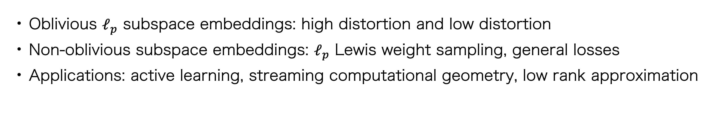
Subspace Embeddings and Linear Regression
Oblivious $ℓ_{p}$ subspace embeddings: high distortion and low distortion
Non-oblivious subspace embeddings: $ℓ_{p}$ Lewis weight sampling, general losses
Applications: active learning, streaming computational geometry, low rank approximation

Slide 6
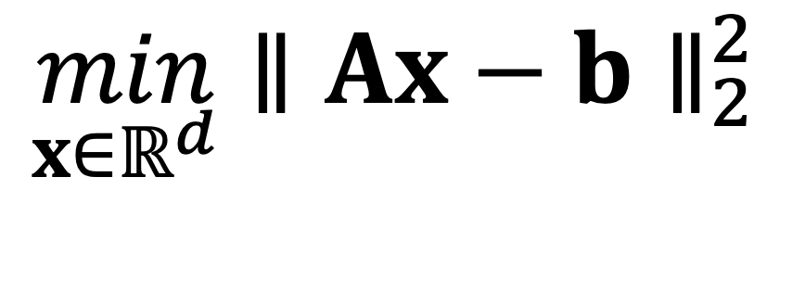
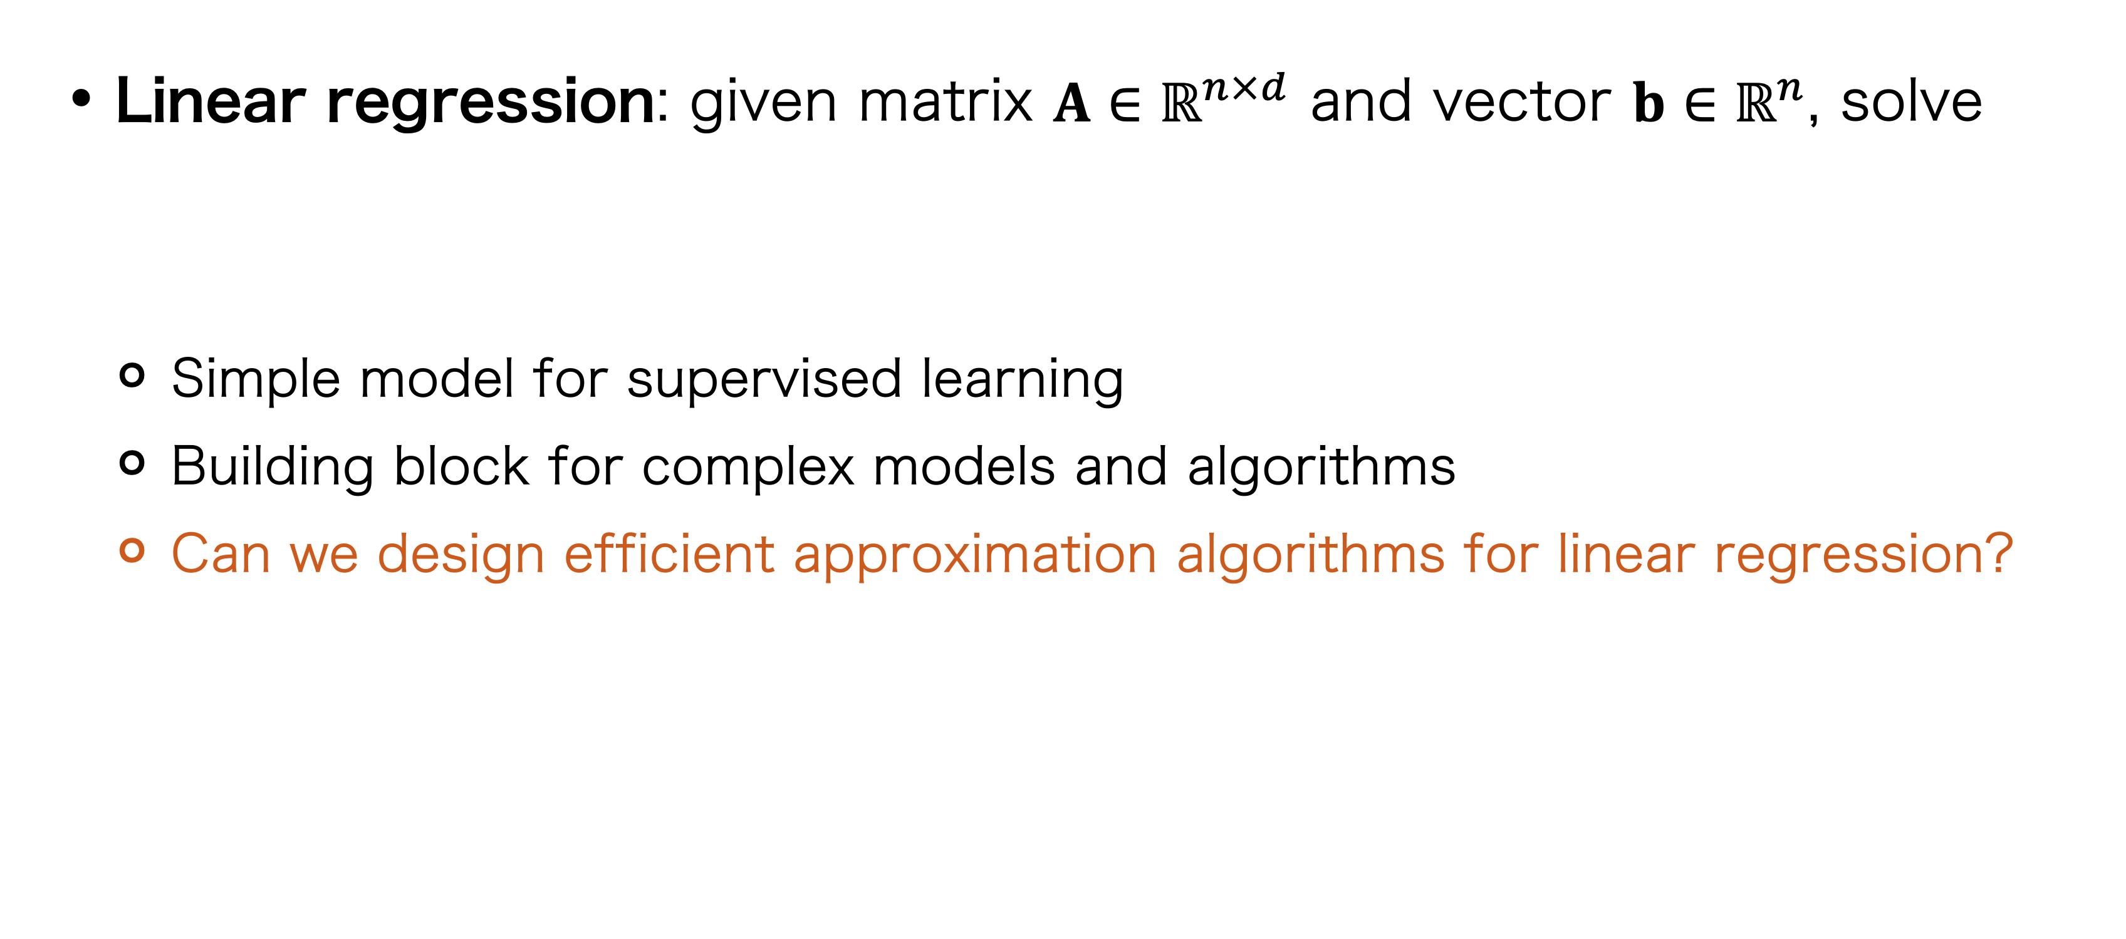
Matrix Approximation
Linear Regression
Linear regression: given matrix $A∈ℝ^{n×d}$ and vector $b∈ℝ^{n}$, solve
Simple model for supervised learning
Building block for complex models and algorithms
Can we design efficient approximation algorithms for linear regression?
$$\min_{x∈ℝ^{d}}{∥Ax−b∥}_{2}^{2}$$

Slide 7
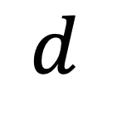
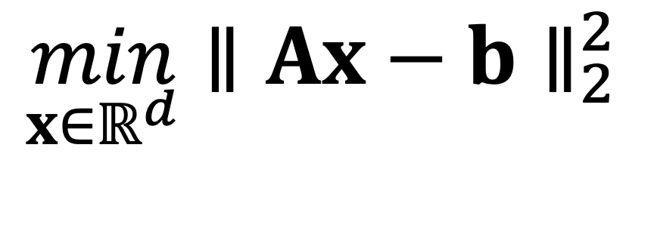
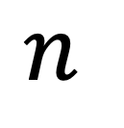
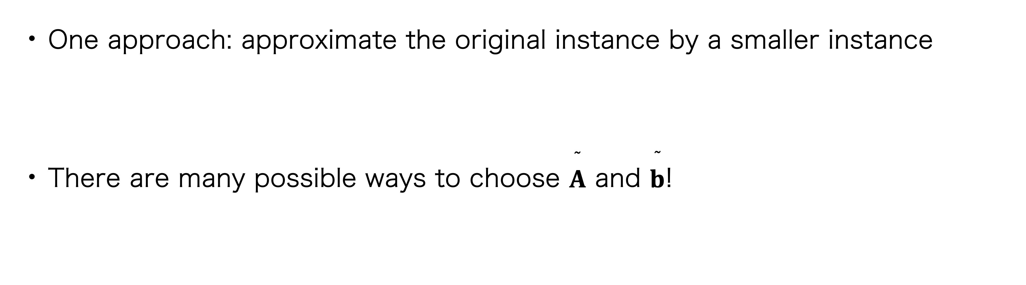
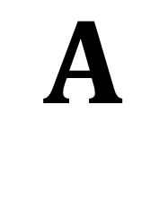
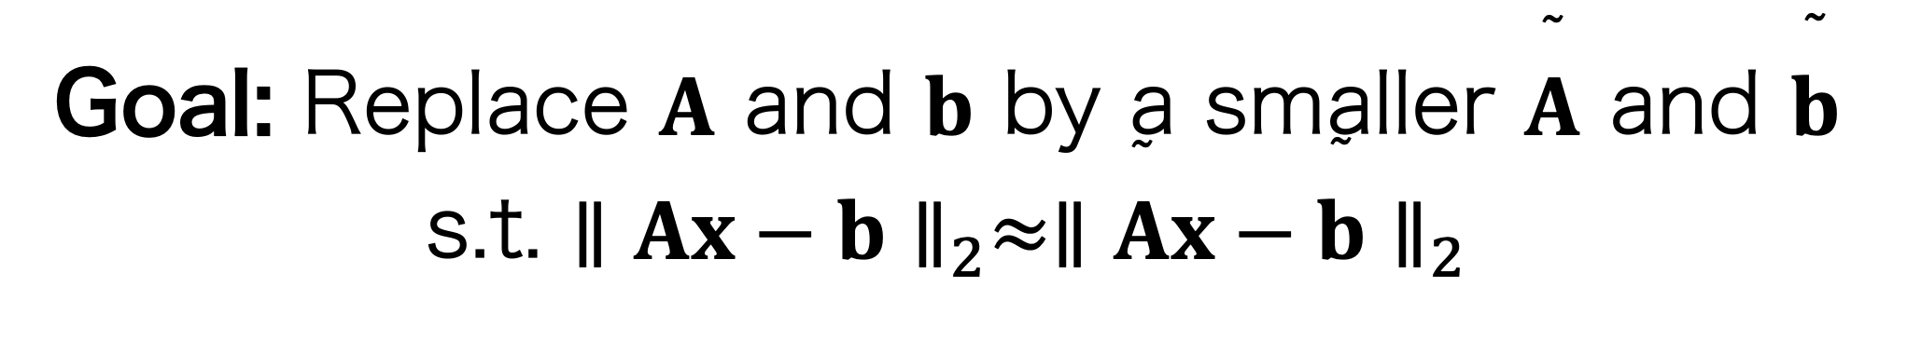
Matrix Approximation
$$d$$
Approximating the Linear Regression Loss Function
$$A$$
$$n$$
$$\min_{x∈ℝ^{d}}{∥Ax−b∥}_{2}^{2}$$
One approach: approximate the original instance by a smaller instance
There are many possible ways to choose $\overset{˜}{A}$ and $\overset{˜}{b}$!
Goal: Replace $A$ and $b$ by a smaller $\overset{˜}{A}$ and $\overset{˜}{b}$ s.t. ${∥Ax−b∥}_{2}≈{∥\overset{˜}{A}x−\overset{˜}{b}∥}_{2}$
Idea. $\overset{˜}{A}=SA$ and $\overset{˜}{b}=Sb$ for some $S∈ℝ^{r×n}$, $r≪n$
“Sketch"

Slide 8

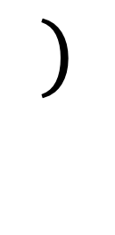
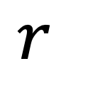

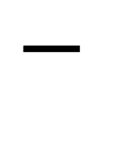
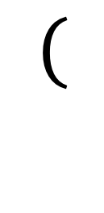
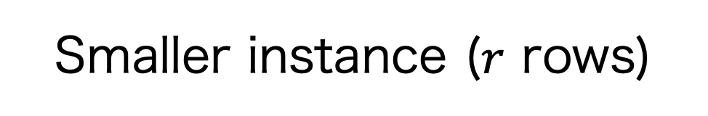

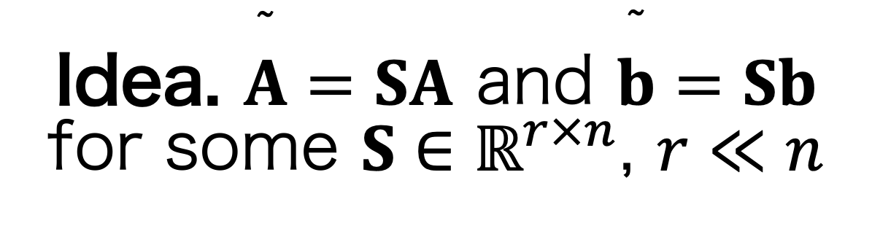



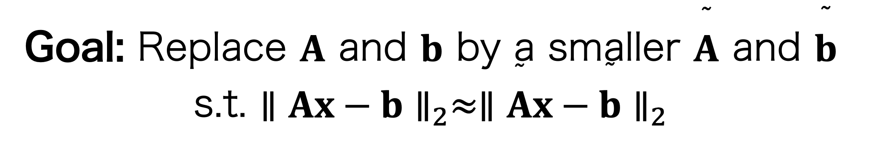
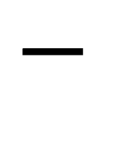
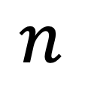
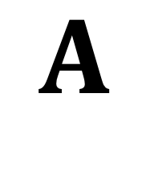


Matrix Approximation
Approximating the Linear Regression Loss Function
Goal: Replace $A$ and $b$ by a smaller $\overset{˜}{A}$ and $\overset{˜}{b}$ s.t. ${∥Ax−b∥}_{2}≈{∥\overset{˜}{A}x−\overset{˜}{b}∥}_{2}$
Idea. $\overset{˜}{A}=SA$ and $\overset{˜}{b}=Sb$ for some $S∈ℝ^{r×n}$, $r≪n$
$$n$$
$$S$$
$$($$
$$A$$
$$x$$
$$−$$
$$b$$
$$)$$
$$=$$
$$SA$$
$$x$$
$$−$$
$$Sb$$
$$r$$
Sketch
Original instance ($n$ rows)
Smaller instance ($r$ rows)

Slide 9
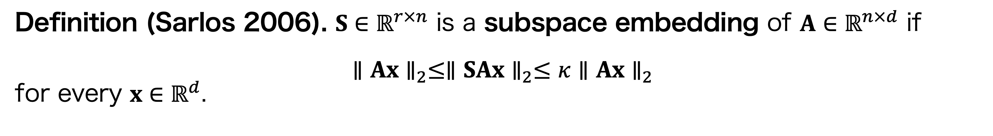
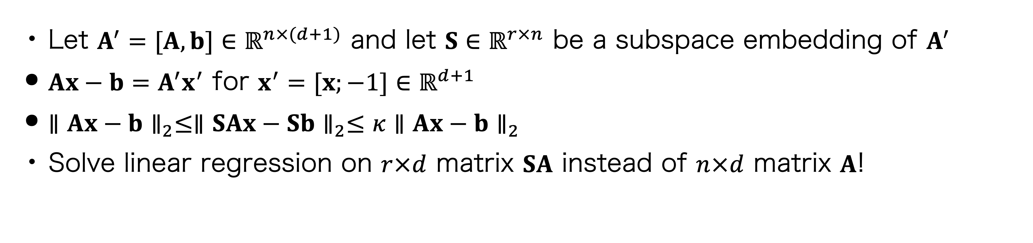
Matrix Approximation
Approximating the Linear Regression Loss Function
Definition (Sarlos 2006). $S∈ℝ^{r×n}$ is a subspace embedding of $A∈ℝ^{n×d}$ if
$$∥Ax∥_{2}≤∥SAx∥_{2}≤κ∥Ax∥_{2}$$
for every $x∈ℝ^{d}$.
Distortion/error
Why is this useful?
Let $A^{′}=[A, b]∈ℝ^{n×(d+1)}$ and let $S∈ℝ^{r×n}$ be a subspace embedding of $A^{′}$
$Ax−b=A^{′}x^{′}$ for $x^{′}=[x;−1]∈ℝ^{d+1}$
$∥Ax−b∥_{2}≤∥SAx−Sb∥_{2}≤κ∥Ax−b∥_{2}$
Solve linear regression on $r×d$ matrix $SA$ instead of $n×d$ matrix $A$!
Cost of $SA$ and $Sb$ approximates cost of $A$ and $b$

Slide 10
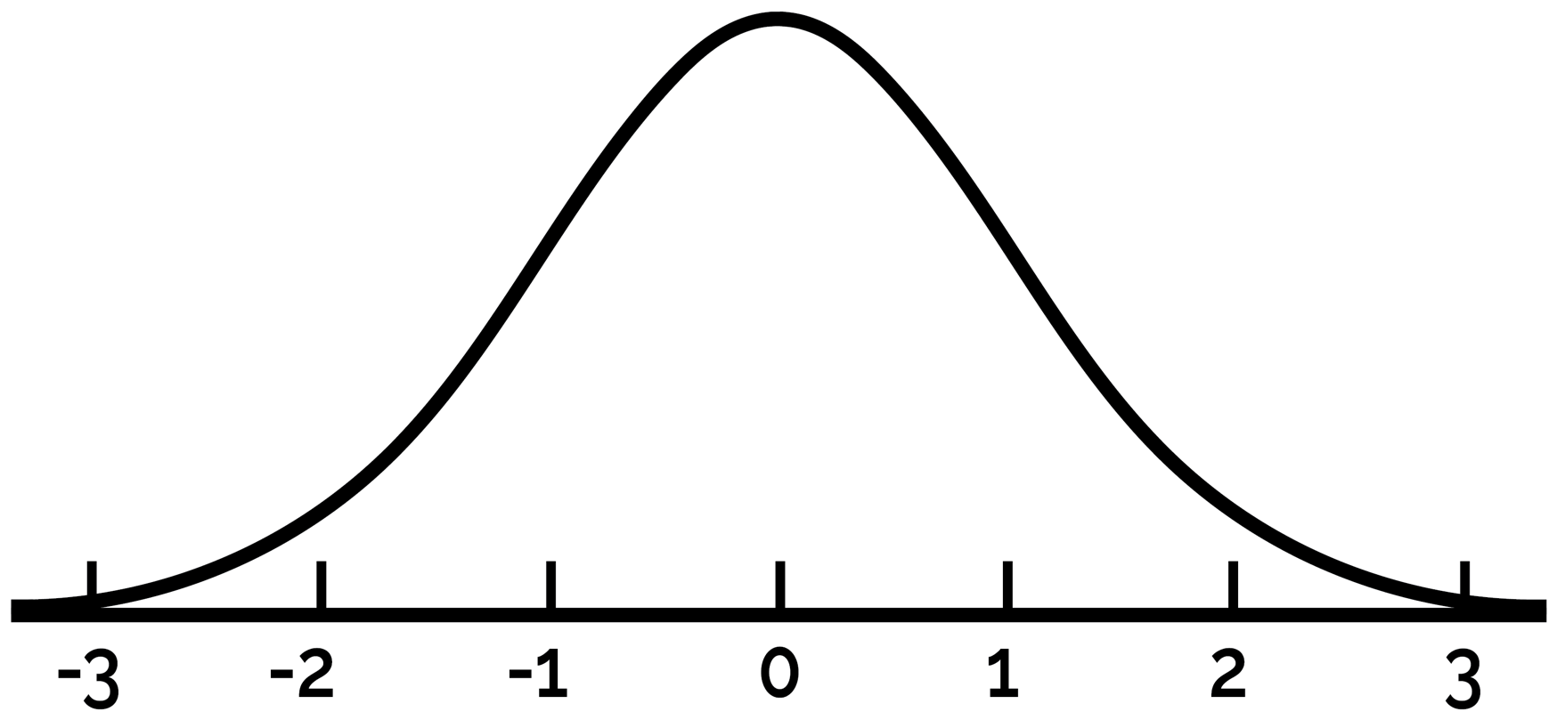
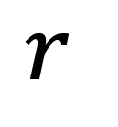


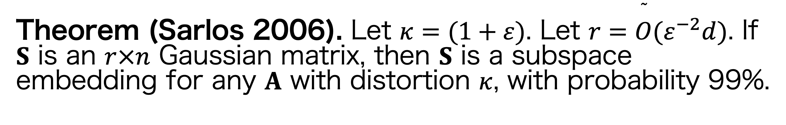

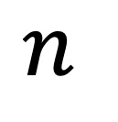
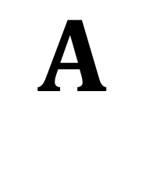
Matrix Approximation
Oblivious Subspace Embeddings
Theorem (Sarlos 2006). Let $κ=(1+ε)$. Let $r=\overset{˜}{O}(ε^{−2}d)$. If $S$ is an $r×n$ Gaussian matrix, then $S$ is a subspace embedding for any $A$ with distortion $κ$, with probability 99%.
$$d$$
$$n$$
$$S$$
$$A$$
$$r$$
$$n$$
So $ℓ_{2}$ regression is resolved.
What’s next?
Oblivious = does not depend on $A$

Slide 11
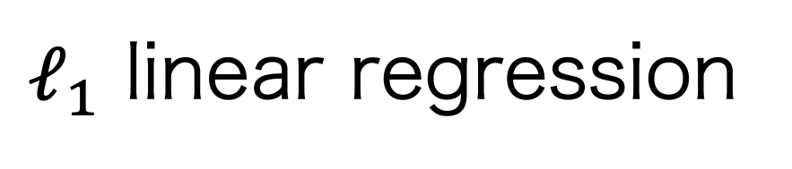
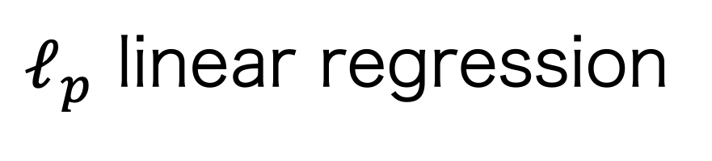
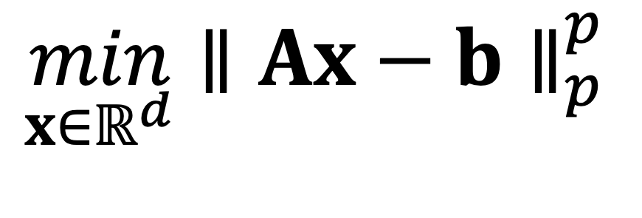
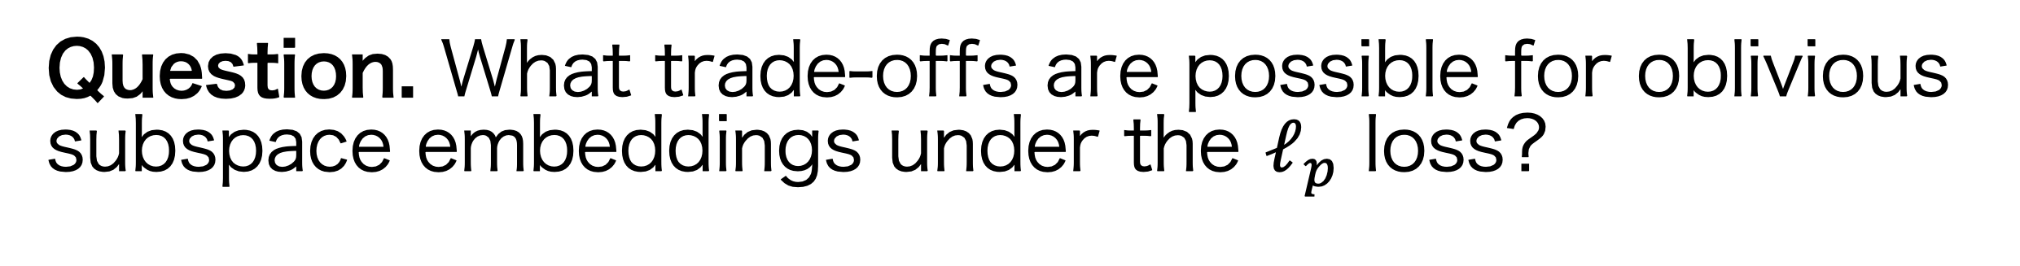
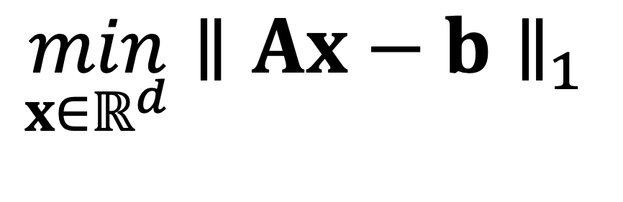
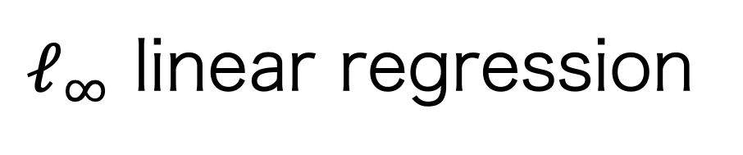
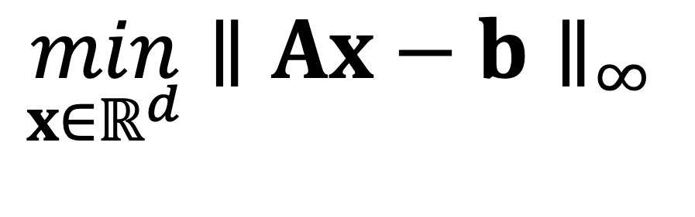
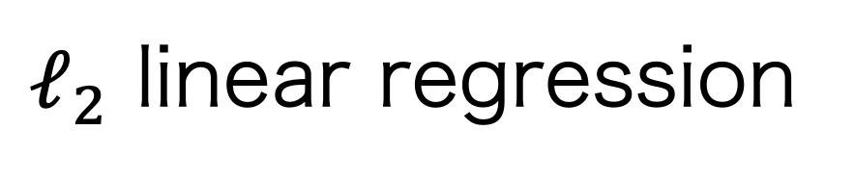
Matrix Approximation
$ℓ_{p}$ Linear Regression
$ℓ_{1}$ linear regression
$ℓ_{2}$ linear regression
$ℓ_{∞}$ linear regression
$$\min_{x∈ℝ^{d}}{∥Ax−b∥}_{1}$$
$$\min_{x∈ℝ^{d}}{∥Ax−b∥}_{2}^{2}$$
$$\min_{x∈ℝ^{d}}{∥Ax−b∥}_{∞}$$
Minimize the average error
Robust loss function
Minimize the sum of squares of errors
Minimize the worst-case error
Sensitive loss function
$ℓ_{p}$ linear regression
$$\min_{x∈ℝ^{d}}{∥Ax−b∥}_{p}^{p}$$
Question. What trade-offs are possible for oblivious subspace embeddings under the $ℓ_{p}$ loss?

Slide 12

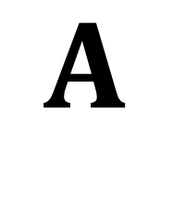
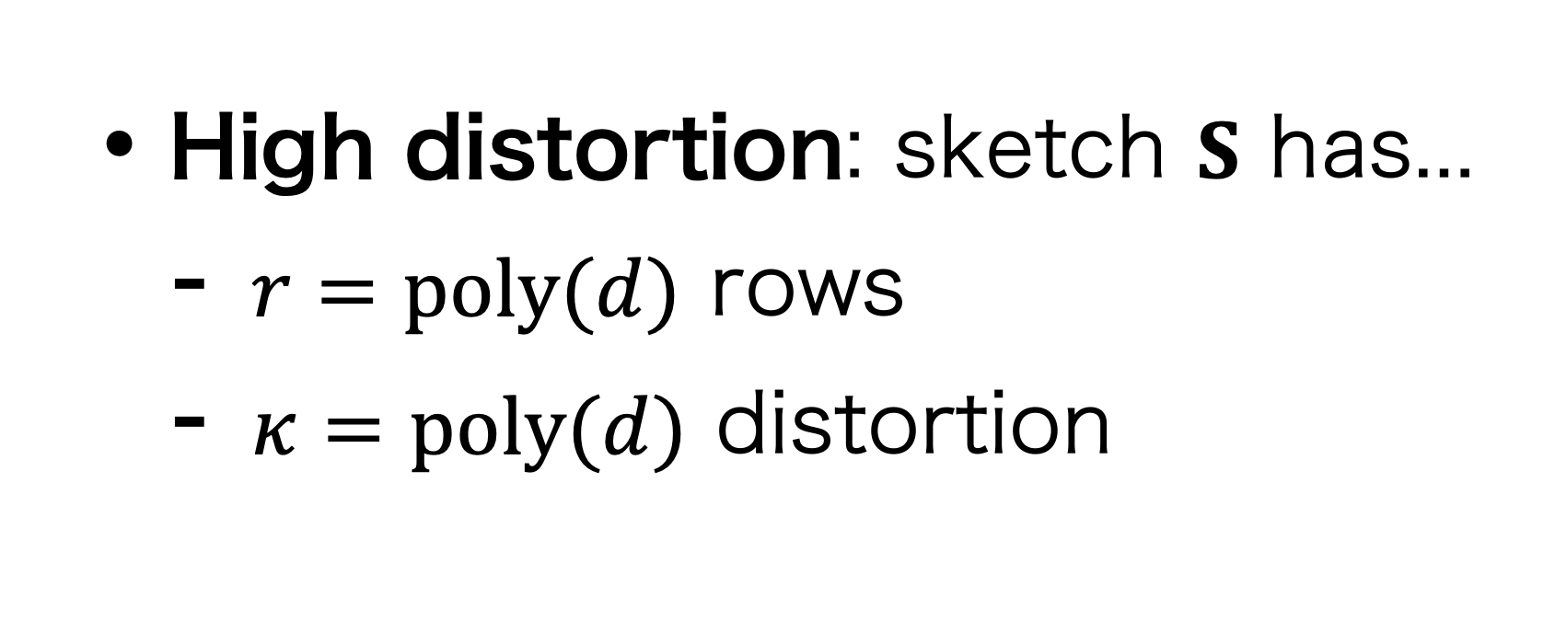

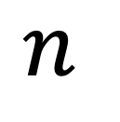
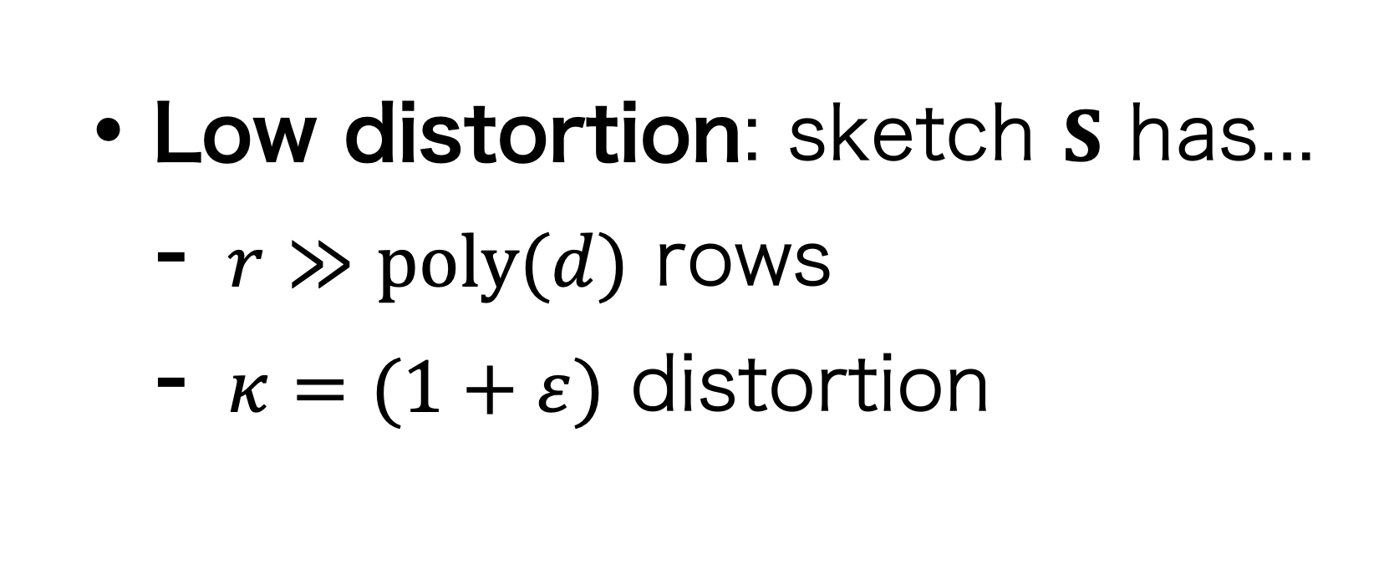
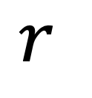
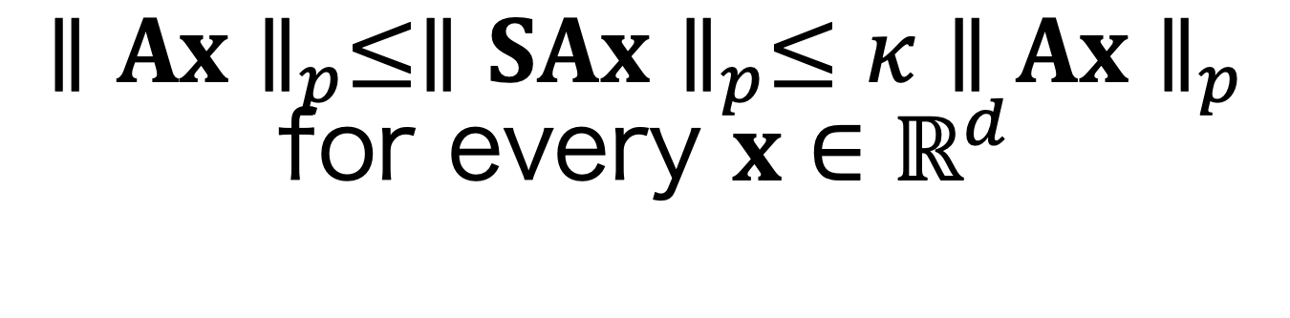
Matrix Approximation
Oblivious $ℓ_{p}$ Subspace Embeddings
Two regimes for $1≤p<2$
High distortion: sketch $S$ has...
$r=poly(d)$ rows
$κ=poly(d)$ distortion
Low distortion: sketch $S$ has...
$r≫poly(d)$ rows
$κ=(1+ε)$ distortion
$$d$$
$$n$$
$$S$$
$$A$$
$$∥Ax∥_{p}≤∥SAx∥_{p}≤κ∥Ax∥_{p}$$
for every $x∈ℝ^{d}$
$$r$$
$$n$$
Oblivious = does not depend on $A$

Slide 13
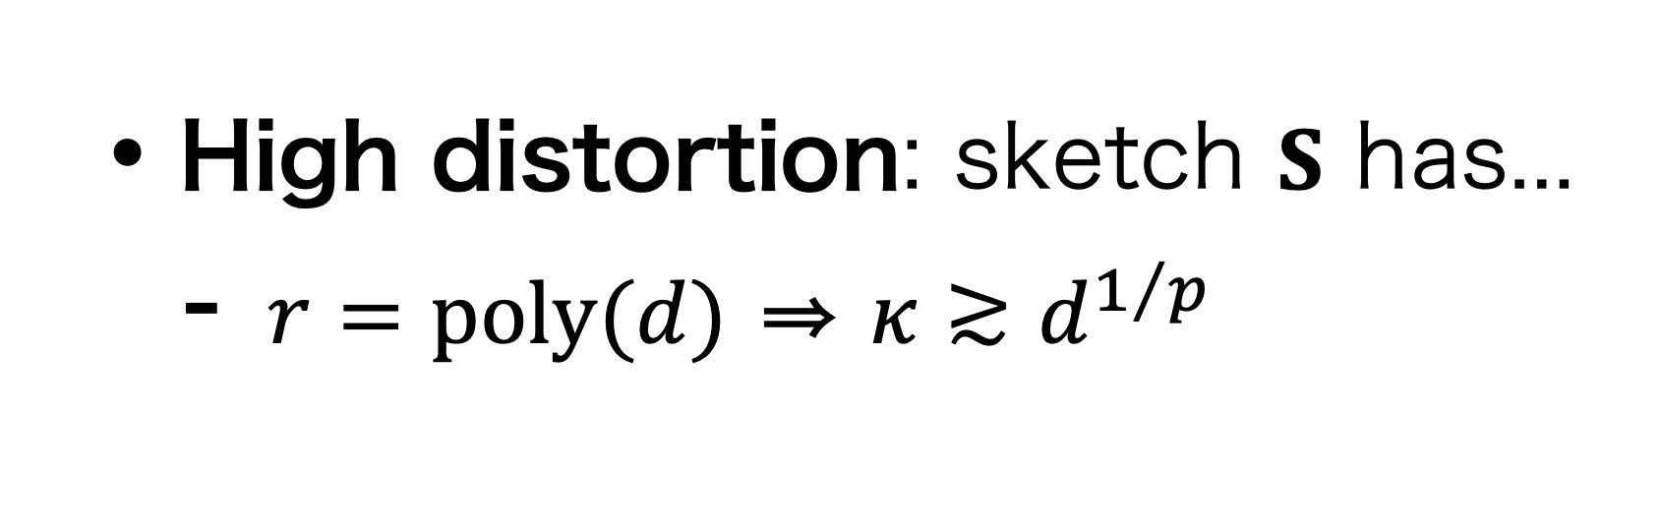
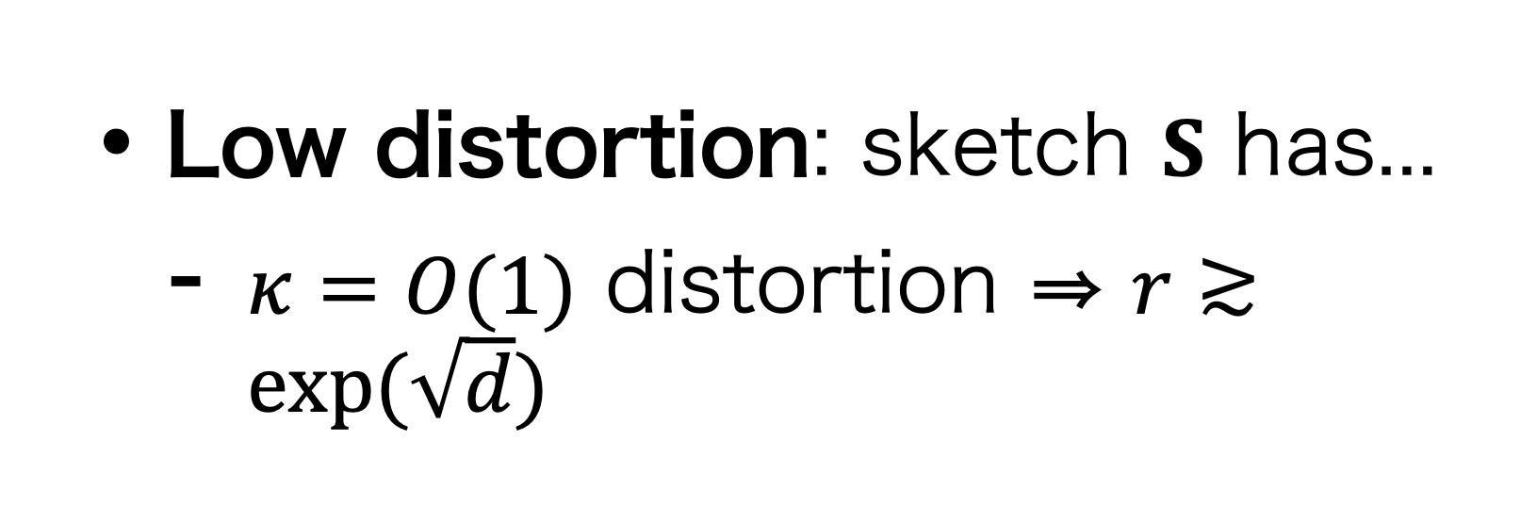
Matrix Approximation
Oblivious $ℓ_{p}$ Subspace Embeddings
Two regimes for $1≤p<2$
High distortion: sketch $S$ has...
$r=poly(d)$ rows
$κ=poly(d)$ distortion
Low distortion: sketch $S$ has...
$r≫poly(d)$ rows
$κ=(1+ε)$ distortion
Best of both worlds is not possible! (Wang—Woodruff 2019)
High distortion: sketch $S$ has...
$r=poly(d)$ ⇒ $κ≳d^{1/p}$
Low distortion: sketch $S$ has...
$κ=O(1)$ distortion ⇒ $r≳exp(\sqrt{d})$

Slide 14
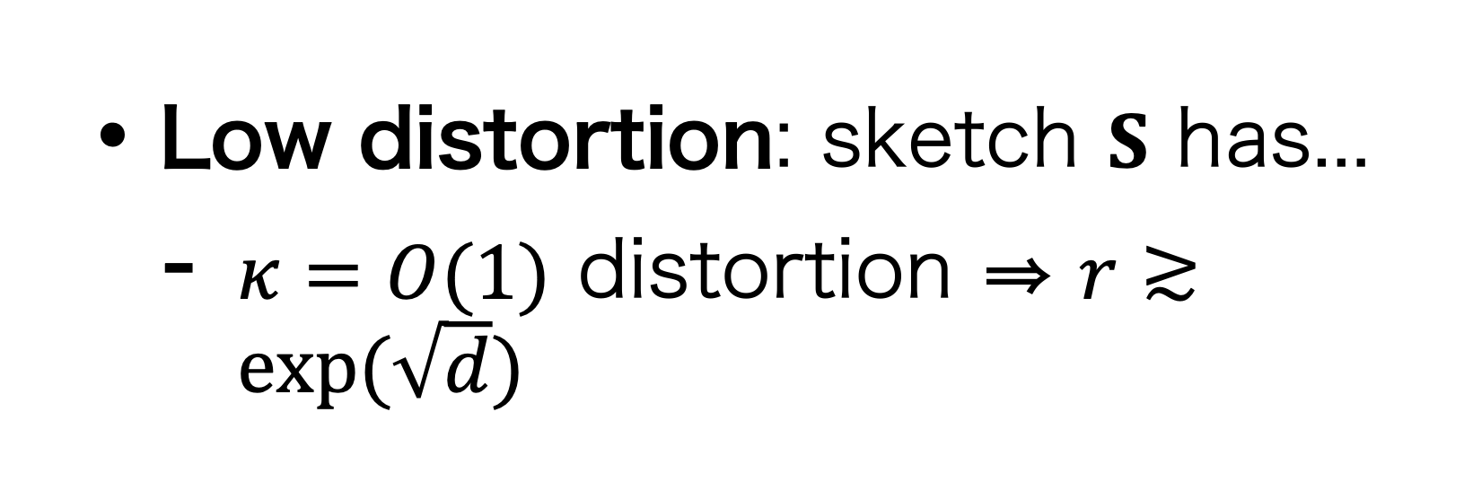
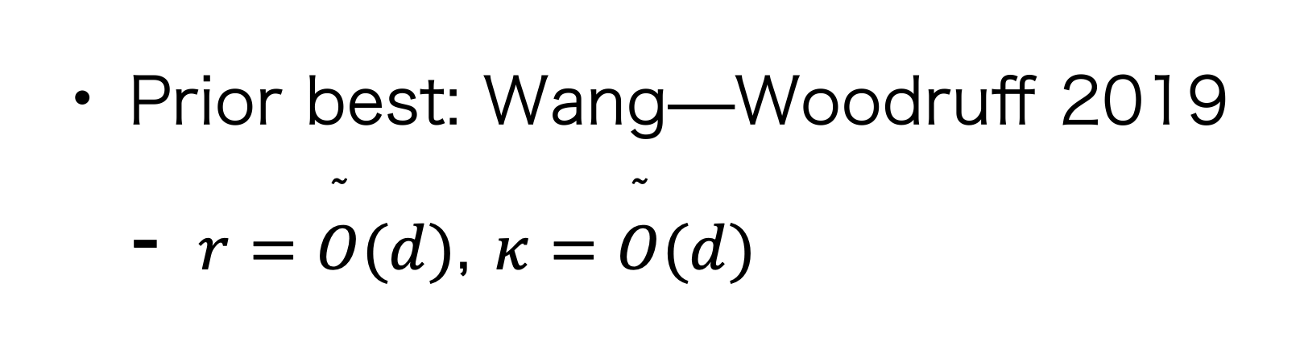
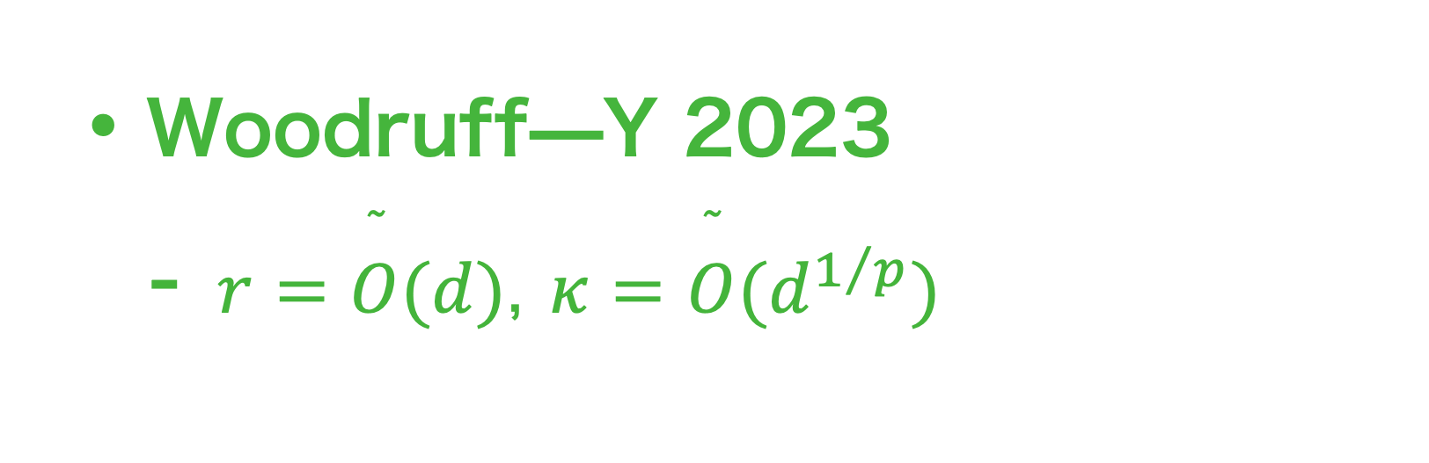
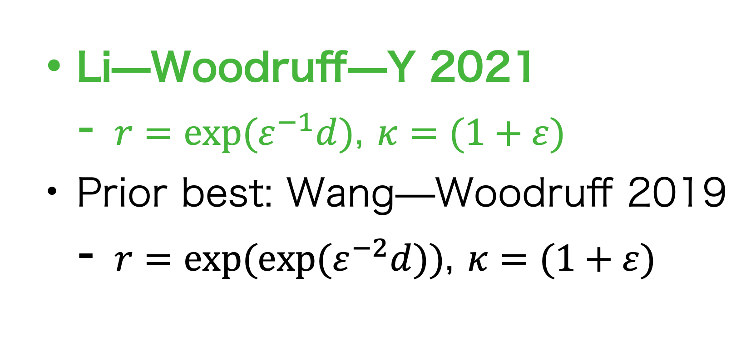
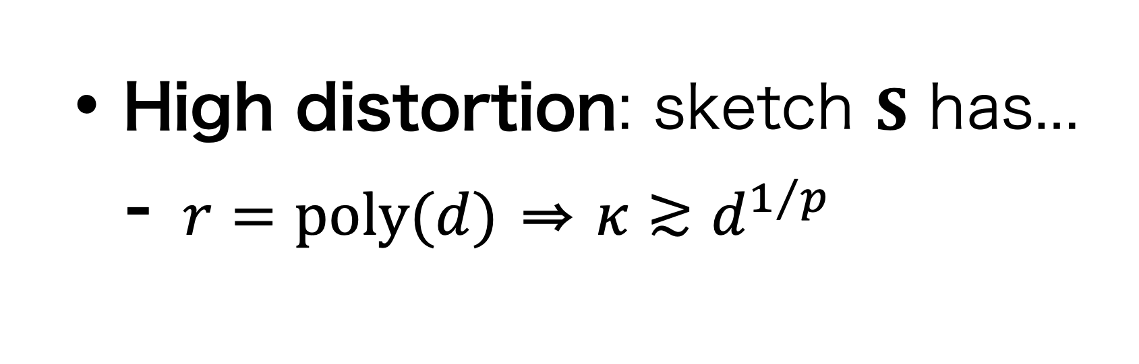
Matrix Approximation
Oblivious $ℓ_{p}$ Subspace Embeddings
Best of both worlds is not possible! (Wang—Woodruff 2019)
High distortion: sketch $S$ has...
$r=poly(d)$ ⇒ $κ≳d^{1/p}$
Low distortion: sketch $S$ has...
$κ=O(1)$ distortion ⇒ $r≳exp(\sqrt{d})$
Question. Are the lower bounds of Wang—Woodruff 2019 tight?
Yes!
Almost!
Woodruff—Y 2023
$r=\overset{˜}{O}(d)$, $κ=\overset{˜}{O}(d^{1/p})$
Li—Woodruff—Y 2021
$r=exp(ε^{−1}d)$, $κ=(1+ε)$
Prior best: Wang—Woodruff 2019
$r=exp(exp(ε^{−2}d))$, $κ=(1+ε)$
Prior best: Wang—Woodruff 2019
$r=\overset{˜}{O}(d)$, $κ=\overset{˜}{O}(d)$

Slide 15
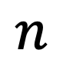
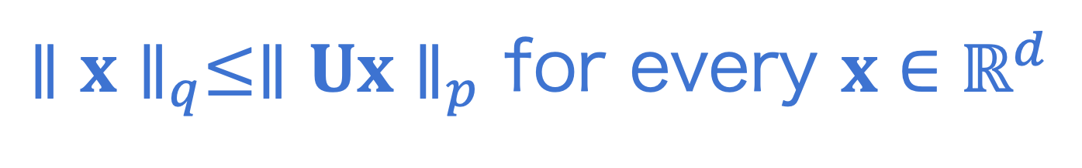

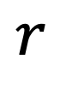











Matrix Approximation
$$d$$
Oblivious $ℓ_{p}$ Subspace Embeddings
$$n$$
Fact. Oblivious $ℓ_{p}$ subspace embeddings reduce to constructing well-conditioned bases for subspaces
$$S$$
$$A$$
$$r$$
$$n$$
≈ orthonormal bases for $ℓ_{p}$ norms
Let $U$ be an orthonormal basis for $A$
$∥U∥_{F}≤d^{1/2}$ (with equality)
$∥x∥_{2}≤∥Ux∥_{2}$ for every $x∈ℝ^{d}$ (with equality)
Theorem (Auerbach 1930). For any $A$, there is $U$ with $α=d$.
well-conditioned basis
$$∥U∥_{p,p}≤α$$
entrywise $ℓ_{p}$ norm
Conjecture. For any $A$, there is $U$ with $α=d^{1/p}$.
$∥x∥_{q}≤∥Ux∥_{p}$ for every $x∈ℝ^{d}$
No success in showing this conjecture! ☹️
Hölder conjugate, $\frac{1}{p}+\frac{1}{q}=1$

Slide 16


Matrix Approximation
$$d$$
Oblivious $ℓ_{p}$ Subspace Embeddings
$$n$$
Fact. Oblivious $ℓ_{p}$ subspace embeddings reduce to constructing well-conditioned bases for subspaces
$$S$$
$$A$$
$$r$$
$$n$$
≈ orthonormal bases for $ℓ_{p}$ norms
Idea. What if we relax well-conditioned bases to well-conditioned spanning sets?
Theorem (Auerbach 1930). For any $A$, there is $U$ with $α=d$.
Theorem (Woodruff—Y 2023). For any $A$, there is $U∈ℝ^{n×s}$ for $s=O(dloglogd)$ such that
$∥U∥_{p,p}≤s^{1/p}$
for every $z∈ℝ^{d}$, there is $x∈ℝ^{s}$ such that $Az=Ux$ and $∥x∥_{2}≤∥Ux∥_{p}$
Conjecture. For any $A$, there is $U$ with $α=d^{1/p}$.
No success in showing this conjecture! ☹️
≈ as good as showing $α=s^{1/p}$

Slide 17

Matrix Approximation
$$d$$
Oblivious $ℓ_{p}$ Subspace Embeddings
$$n$$
Fact. Oblivious $ℓ_{p}$ subspace embeddings reduce to constructing well-conditioned bases for subspaces
$$S$$
$$A$$
$$r$$
$$n$$
≈ orthonormal bases for $ℓ_{p}$ norms
Idea. What if we relax well-conditioned bases to well-conditioned spanning sets?
Theorem (Woodruff—Y 2023). For any $A$, there is $U∈ℝ^{n×s}$ for $s=O(dloglogd)$ such that
$∥U∥_{p,p}≤s^{1/p}$
for every $z∈ℝ^{d}$, there is $x∈ℝ^{s}$ such that $Az=Ux$ and $∥x∥_{2}≤∥Ux∥_{p}$
Theorem (Woodruff—Y 2023). There are oblivious $ℓ_{p}$ subspace embeddings with $r=\overset{˜}{O}(d)$ and $κ=\overset{˜}{O}(d^{1/p})$, which is nearly optimal.

Slide 18
Matrix Approximation
Oblivious $ℓ_{p}$ Subspace Embeddings
Li—Woodruff—Y 2021
Mahoney—Meng,
Woodruff—Zhang 2013
Sarlos 2006
Sohler—Woodruff 2011
Wang—Woodruff 2019
Woodruff—Y 2023

Slide 19

Subspace Embeddings and Linear Regression
Oblivious $ℓ_{p}$ subspace embeddings: high distortion and low distortion
Non-oblivious subspace embeddings: $ℓ_{p}$ Lewis weight sampling, general losses
Applications: active learning, streaming computational geometry, low rank approximation

Slide 20









Matrix Approximation
Non-oblivious Subspace Embeddings
$$S$$
$$A$$
Oblivious
Oblivious = does not depend on $A$
Step 1. Compute “importance scores” for the rows of $A$
$$q_{1}$$
$$q_{2}$$
Non-oblivious/ Sampling
$$S$$
$$A$$
$$SA$$
$$⋮$$
Step 2. Sample rows proportionally to the importance scores
$$q_{n}$$

Slide 21

Matrix Approximation
Non-oblivious Subspace Embeddings
Theorem (Leverage score sampling). For any $A∈ℝ^{n×d}$, there are probabilities $q_{1},q_{2},…q_{n}$ that sample $r=\overset{˜}{O}(ε^{−2}d)$ rows of $A$ that forms an $ℓ_{2}$
subspace embedding with distortion $κ=(1+ε)$, with probability 99%.
Step 1. Compute “importance scores” for the rows of $A$
$$q_{1}$$
$$q_{2}$$
Non-oblivious/ Sampling
$$S$$
$$A$$
$$SA$$
$$⋮$$
Step 2. Sample rows proportionally to the importance scores
$$q_{n}$$

Slide 22


Matrix Approximation
Non-oblivious Subspace Embeddings
Theorem (Leverage score sampling). For any $A∈ℝ^{n×d}$, there are probabilities $q_{1},q_{2},…q_{n}$ that sample $r=\overset{˜}{O}(ε^{−2}d)$ rows of $A$ that forms an $ℓ_{2}$
subspace embedding with distortion $κ=(1+ε)$, with probability 99%.
Same row count ($r$) vs distortion ($κ$) trade-off as the oblivious case...
Generalizes to much better trade-offs for $ℓ_{p}$ norms with $p≠2$!
Oblivious: either $κ=poly(d)$ or $r≫poly(d)$, and only for $p≤2$...
Non-oblivious: $κ=(1+ε)$ and $r=poly(d)$ for any fixed $p$!
$$SA$$

Slide 23





Matrix Approximation
Non-oblivious Subspace Embeddings
Definition (Leverage scores). For $A∈ℝ^{n×d}$ and $i∈[n]$, the $i$th leverage score is
$$τ_{i}(A)=\sup_{Ax≠0}\frac{⟨a_{i},x⟩^{2}}{∥Ax∥_{2}^{2}}$$
Contribution of the $i$th coordinate
$ℓ_{2}$ norm of $Ax$
“Importance score”: largest fraction of $ℓ_{2}$ norm occupied by the $i$th coordinate
Many generalizations:
$ℓ_{p}$ sensitivity scores (Langberg—Schulman 2010)
$ℓ_{p}$ Lewis weights (Lewis 1978)
Online leverage scores (Cohen—Musco—Pachocki 2016)
$$SA$$

Slide 24

Matrix Approximation
Non-oblivious Subspace Embeddings
Question 3. Are there similar results for other loss functions?
$$∥Ax∥_{g}:=\overset{n}{\underset{i=1}{∑}}g([Ax](i))$$
There are many other loss functions used for linear regression...
Huber/Tukey loss for robust statistics
Logistic regression for classification
$$SA$$

Slide 25



Matrix Approximation
Non-oblivious Subspace Embeddings
Question 3. Are there similar results for other loss functions?
$$∥Ax∥_{g}:=\overset{n}{\underset{i=1}{∑}}g([Ax](i))$$
Musco—Musco—Woodruff—Y 2022
General losses with quadratic growth
$$r=\overset{˜}{O}(ε^{−2}d^{2})$$
$$r=poly(ε^{−1})d^{4−2\sqrt{2}}≈d^{1.172}$$
$$SA$$
Huber loss
I am very interested in improving this to $d$

Slide 26
Subspace Embeddings and Linear Regression
Oblivious $ℓ_{p}$ subspace embeddings: high distortion and low distortion
Non-oblivious subspace embeddings: $ℓ_{p}$ Lewis weight sampling, general losses
Applications: active learning, streaming computational geometry, low rank approximation

Slide 27

Matrix Approximation
Active $ℓ_{p}$ Linear Regression
$$\min_{x∈ℝ^{d}}{∥Ax−b∥}_{p}^{p}$$
Active learning: machine learning, where label acquisition is the most expensive resource
Labeling could require manual labor
Labeling could require purchasing information
Labeling could require involve an invasive medical procedure
Goal: minimize the number of label entries that are read

Slide 28






Matrix Approximation
Active $ℓ_{p}$ Linear Regression
$$\min_{x∈ℝ^{d}}{∥Ax−b∥}_{p}^{p}$$
$b$ vector is hidden, and the algorithm has query access to it
The algorithm has full access to $A$
$$A$$
$$x$$
$$−$$
$$b$$
Question. How many entries of $b$ need to be read?

Slide 29


Matrix Approximation
Active $ℓ_{p}$ Linear Regression
$$\min_{x∈ℝ^{d}}{∥Ax−b∥}_{p}^{p}$$
Sampling-based $ℓ_{p}$ subspace embedding for $A$
$$S$$
$$A$$
$$x$$
$$−$$
$$b$$
Question. How many entries of $b$ need to be read?

Slide 30

Matrix Approximation
Active $ℓ_{p}$ Linear Regression
$$\min_{x∈ℝ^{d}}{∥Ax−b∥}_{p}^{p}$$
$$SA$$
$$x$$
$$−$$
$$b$$
Question. How many entries of $b$ need to be read?

Slide 31



Matrix Approximation
Active $ℓ_{p}$ Linear Regression
$$\min_{x∈ℝ^{d}}{∥Ax−b∥}_{p}^{p}$$
$p=2$: $Θ(ε^{−1}d)$ (Chen—Price 2019)
$p=1$: $\overset{˜}{Θ}(ε^{−2}d)$ (Chen—Derezinski, Parulekar—Parulekar—Price 2021)
$1<p<2$: $\overset{˜}{O}(ε^{−2}d^{2})$ (Chen—Derezinski 2021)
$2<p<∞$: $\overset{˜}{Θ}(ε^{1−p}d^{p/2})$ (Woodruff—Y 2023)
$$SA$$
$$x$$
$$−$$
$$b$$
$\overset{˜}{Θ}(ε^{−1}d)$ (Musco—Musco—Woodruff—Y 2022)
Question. How many entries of $b$ need to be read?

Slide 32









Matrix Approximation
Streaming Löwner—John Ellipsoids
Input: symmetric polytope with $2n$ faces in $d$ dims
Agarwal—Har-Peled—Varadarajan 2004: $exp(Θ(d))$ bits
Woodruff—Y 2022: $O(d^{2}\log^{2}n)$ bits
Want the “largest” ellipsoid enclosed in polytope
$$\{x:|⟨a_{i},x⟩|≤1\}$$
Approach: select a subset of constraints
Techniques: use leverage scores to...
test if ellipsoid respects a new constraint $a_{i}$
bound # of times we keep a new constraint $a_{i}$
$$\{x:∥Ex∥_{2}^{2}≤1\}$$
$$\sup_{Ex≠0}\frac{⟨a_{i},x⟩^{2}}{∥Ex∥_{2}^{2}}$$
$≤1$ iff ellipsoid $E$ respects constraint $a_{i}$
Question. Can Löwner—John ellipsoids be maintained in $poly(d,logn)$ bits of space?
Leverage scores: $τ_{i}(A)=\sup_{Ax≠0}\frac{⟨a_{i},x⟩^{2}}{∥Ax∥_{2}^{2}}$

Slide 33




Matrix Approximation
Low Rank Approximation with General Losses
$$\min_{U∈ℝ^{n×k},V∈ℝ^{k×d}}{∥A−UV∥}_{p,p}^{p}=\underset{i,j}{∑}|(A−UV)_{i,j}|^{p}$$
$$\min_{U∈ℝ^{n×k},V∈ℝ^{k×d}}{∥A−UV∥}_{F}^{2}$$
$$\min_{U∈ℝ^{n×k},V∈ℝ^{k×d}}{∥A−UV∥}_{g}=\underset{i,j}{∑}g(|(A−UV)_{i,j}|)$$
NP-hard... → need approximation/bicriteria algorithms
Focus on column subset selection algorithms: $U$ is a set of$≈k$ columns of $A$
Useful for unsupervised feature selection
This framework gives the best known algorithms for this problem!

Slide 34








Matrix Approximation
Low Rank Approximation with General Losses
$$\min_{U∈ℝ^{n×k},V∈ℝ^{k×d}}{∥A−UV∥}_{g}=\underset{i,j}{∑}g(|(A−UV)_{i,j}|)$$
$${∥A−\overset{̂}{U}\overset{̂}{V}∥}_{g}≤κ\min_{U∈ℝ^{n×k},V∈ℝ^{k×d}}{∥A−UV∥}_{g}$$
Subset of $≈k$ columns of $A$
Approximation factor $κ$
$ℓ_{p}$, $p<2$: $κ≈k^{1/p−1/2}$ (Mahankali—Woodruff 2021)
$ℓ_{p},p>2$: $κ≈k^{1−1/p}$ (Dan—Wang—Zhang—Zhou—Ravikumar 2019)
Huber: $κ≈k^{2}$ (Song—Woodruff—Zhong 2019)
$κ≈k^{1/2−1/p}$ (Woodruff—Y 2023)
Techniques: well-conditioned spanning sets, $ℓ_{p}$ Lewis weights, ...
$κ≈k$ (Woodruff—Y 2023)

Slide 35

Matrix Approximation
Summary
We develop a wide variety of techniques for matrix approximation based on sampling and sketching techniques
Tight bounds: we obtain nearly optimal bounds for fundamental problems for matrix approximation
Uncertain/resource-limited settings: we develop the first algorithms for matrix approximation in online, streaming, and other models of computation
Generalized loss functions: we obtain new and improved algorithms for matrix approximation under $ℓ_{p}$, Huber, and even further general loss functions
Applications: we apply algorithmic techniques from matrix approximation to solve fundamental problems in machine learning and computational geometry

Slide 36



Matrix Approximation
Open Problems
Open Problem 1. Is there a $κ=O(1)$ distortion subspace embedding for the Huber loss with $r≈d$ rows?
Current best: $r≈d^{4−2\sqrt{2}}$ (Musco—Musco—Woodruff—Y 2022)
Open Problem 2. Is $r≈ε^{−2}d^{p/2}$ optimal for $κ=(1+ε)$ distortion $ℓ_{p}$ subspace embeddings for $p>2$?
Current best: $r≳ε^{−2}+d^{p/2}$ (Li—Wang—Woodruff 2020)

Slide 37

Matrix Approximation
Other works
Subspace Embeddings + Applications:
Sharper Bounds for $ℓ_{p}$ Sensitivity Sampling [preprint]
New Subset Selection Algorithms for Low Rank Approximation: Offline and Online [STOC’23]
Online Lewis Weight Sampling [SODA’23]
High-Dimensional Geometric Streaming in Polynomial Space [FOCS’22]
Active Linear Regression for $ℓ_{p}$ Norms and Beyond [FOCS’22]
Exponentially Improved Dimensionality Reduction for $ℓ_{1}$: Subspace Embeddings and Independence Testing [COLT’21]
Low Rank Approximation
New Subset Selection Algorithms for Low Rank Approximation: Offline and Online [STOC’23]
Improved Algorithms for Low Rank Approximation from Sparsity [SODA’22]
Sequential Attention for Feature Selection [ICLR’23]

